Slide 1
Part I Review
Lecture Slides

Slide 2
Part I Review 1
The first and most important question to ask about any statistical study is, Where do the data come from? Chapter 1 addressed this question. The distinction between observational and experimental data is a key part of the answer.
Good statistics starts with good designs for producing data. Chapters 2, 3, and 4 discussed sampling, the art of choosing part of a population to represent the whole.

Slide 3
Part I Review 2
Chapters 5 and 6 dealt with the statistical aspects of designing experiments, studies that impose some treatment in order to learn about the response. The big idea is the randomized comparative experiment.
Random sampling and randomized comparative experiments are, perhaps, the most important statistical inventions of the twentieth century. Both were slow to gain acceptance, and you will still see many voluntary response samples and uncontrolled experiments.

Slide 4
Part I Review 3
Both random samples and randomized experiments involve the deliberate use of chance to eliminate bias and produce a regular pattern of outcomes. The regular pattern allows us to give margins of error, make confidence statements, and assess the statistical significance of conclusions based on samples or experiments.
Chapter 7 discussed ethical issues and introduced three principles that apply to any study with human subjects.

Slide 5
Part I Review 4
The last step in producing data is to measure the characteristics of interest to produce numbers we can work with. Measurement was the subject of Chapter 8.
“Where do the data come from?” is the first question we should ask about a study, and “Do the numbers make sense?” is the second question.
Chapter 9 encouraged the valuable habit of looking skeptically at numbers before accepting what they seem to say.

Slide 6
Part I Review 5
DATA
Recognize the individuals and variables in a statistical study.
Distinguish observational from experimental studies.
Identify sample surveys, censuses, and experiments.

Slide 7
Part I Review 6
SAMPLING
Identify the population in a sampling situation.
Recognize bias due to voluntary response samples and other inferior sampling methods.
Use Table A of random digits to select a simple random sample (SRS) from a population.
Explain how sample surveys deal with bias and variability in their conclusions. Explain in simple language what the margin of error for a sample survey result tells us and what 95% confidence means.

Slide 8
Part I Review 7
SAMPLING
5. Use the quick method to get an approximate margin of error
for 95% confidence.
6. Understand the distinction between sampling errors and
nonsampling errors. Recognize the presence of
undercoverage and nonresponse as sources of error in a
sample survey. Recognize the effect of the wording of
questions on the responses.
7. Use random digits to select a stratified random sample from a
population when the strata are identified.

Slide 9
Part I Review 8
EXPERIMENTS
Explain the differences between observational studies and
experiments.
Identify the explanatory variables, treatments, response
variables, and subjects in an experiment.
Recognize bias due to confounding of explanatory variables
with lurking variables in either an observational study or an experiment.

Slide 10
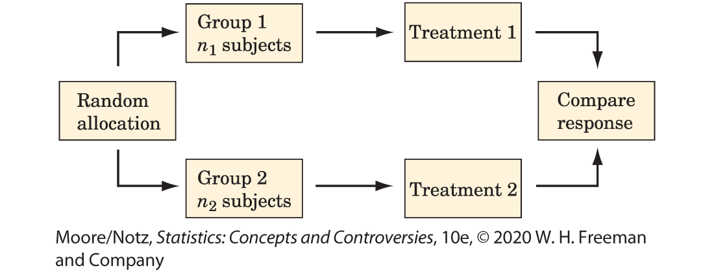
Part I Review 9
EXPERIMENTS
4. Outline the design of a completely randomized experiment
using a diagram like that in Figure I.2. Such a diagram should
show the sizes of the groups, the specific treatments, and the
response variable.

Slide 11
Part I Review 10
EXPERIMENTS
5. Use random digits to carry out the random assignment of
subjects to groups in a completely randomized experiment.
6. Make use of matched pairs or block designs when
appropriate.
7. Recognize the placebo effect.

Slide 12
Part I Review 11
EXPERIMENTS
8. Recognize when the double-blind technique should be used.
9. Be aware of weaknesses in an experiment, especially in the
ability to generalize its conclusions.
10. Explain why a randomized comparative experiment can give
good evidence for cause-and-effect relationships.
11. Explain the meaning of statistical significance.

Slide 13
Part I Review 12
OTHER TOPICS
Explain the three first principles of data ethics (protect
subjects from harm, informed consent, and confidentiality). Discuss how they might apply in specific settings.
Explain how measuring leads to clearly defined variables in
specific settings.
Evaluate the validity of a variable as a measure of a given
characteristic, including predictive validity.

Slide 14
Part I Review 13
OTHER TOPICS
4. Explain how to reduce bias and improve reliability in
measurement.
5. Recognize inconsistent numbers, implausible numbers,
numbers so good they are suspicious, and arithmetic
mistakes.
6. Calculate percentage increase or decrease correctly.

